Slide 1
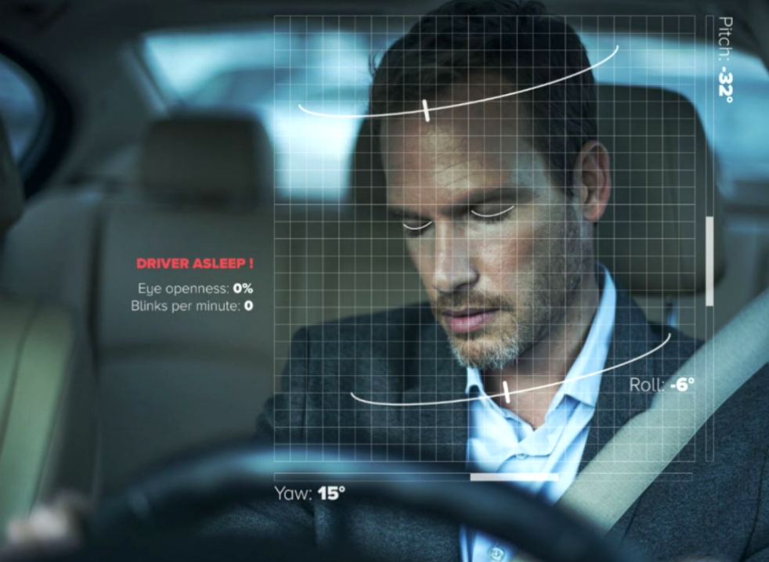
Group 9-Wake up!
Don’t be Drowsiness Driving
Group#09 member： Donggen Li（eaz7wk）
Guang Wu（uzd5zk） Linze Fan（fxp3fw）
Notes:
Hello, we are group-9, Wake up! Our project is about a driver dorwsiness detection sysytem. I'm XXX.

Slide 2
Project Objective
Use Nvidia Jetson Nano platform with provided camera to run inference on image classification tasks for deployed models on the platform locally.
This project aims to develop a real-time drowsiness detection system based on Jetson Nano. The system captures the driver’s facial features such as eye closure and yawning in real-time and analyzes them using deep learning algorithms to identify the signs.
Project Advantages
Cost-Effective
Compared to traditional drowsiness detection systems, the Jetson Nano-based system is more affordable.
Scalability
The system can be expanded with additional features as needed.
Easy Integration
Compact hardware assize and flexible interface design facilitate integration with other in-vehicles systems.
Notes:
Our objective is to use Nvidia Jetson Nano platform with provided camera to run inference on image classification tasks for delpoyed models on the platform locally.
There are several reasons we chose this topic as our project. First, Jetson Nano is a cost-effective hardware platfrom. Compared to traditional detection systems, the Jetson Nano based system is more affordable.
Second, the system can be expanded with additional features as needed.
And it is very easy to be integrated in vehicles systems.

Slide 3
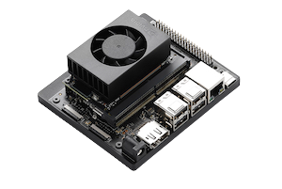
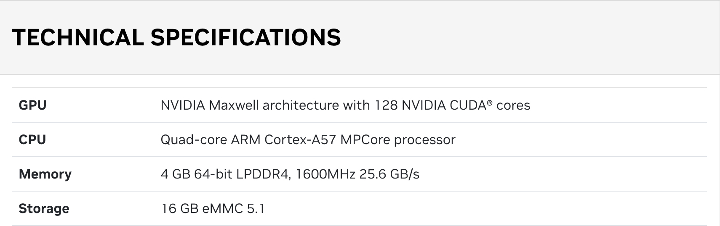
Nvidia Jetson Nano
A small, powerful computer designed for edge AI applications.
Use Cases:
Ideal for edge AI applications like computer vision, robotics and IoT, allowing real-time inference in devices with limited power and space
Power Efficiency:
Designed to operate with low power consumption (as little as 5 watts).
Notes:
Jetson Nano is a small, powerful tiny computer designed for edge AI applications like computer vision, robotics, internet of things and so on.
It allows real-time inference in devices with limited power and space. Also it is a very-easy-to ues platform that runs in as little as 5 watts.
The cpu is an based on ARM-64 architecture.

Slide 4
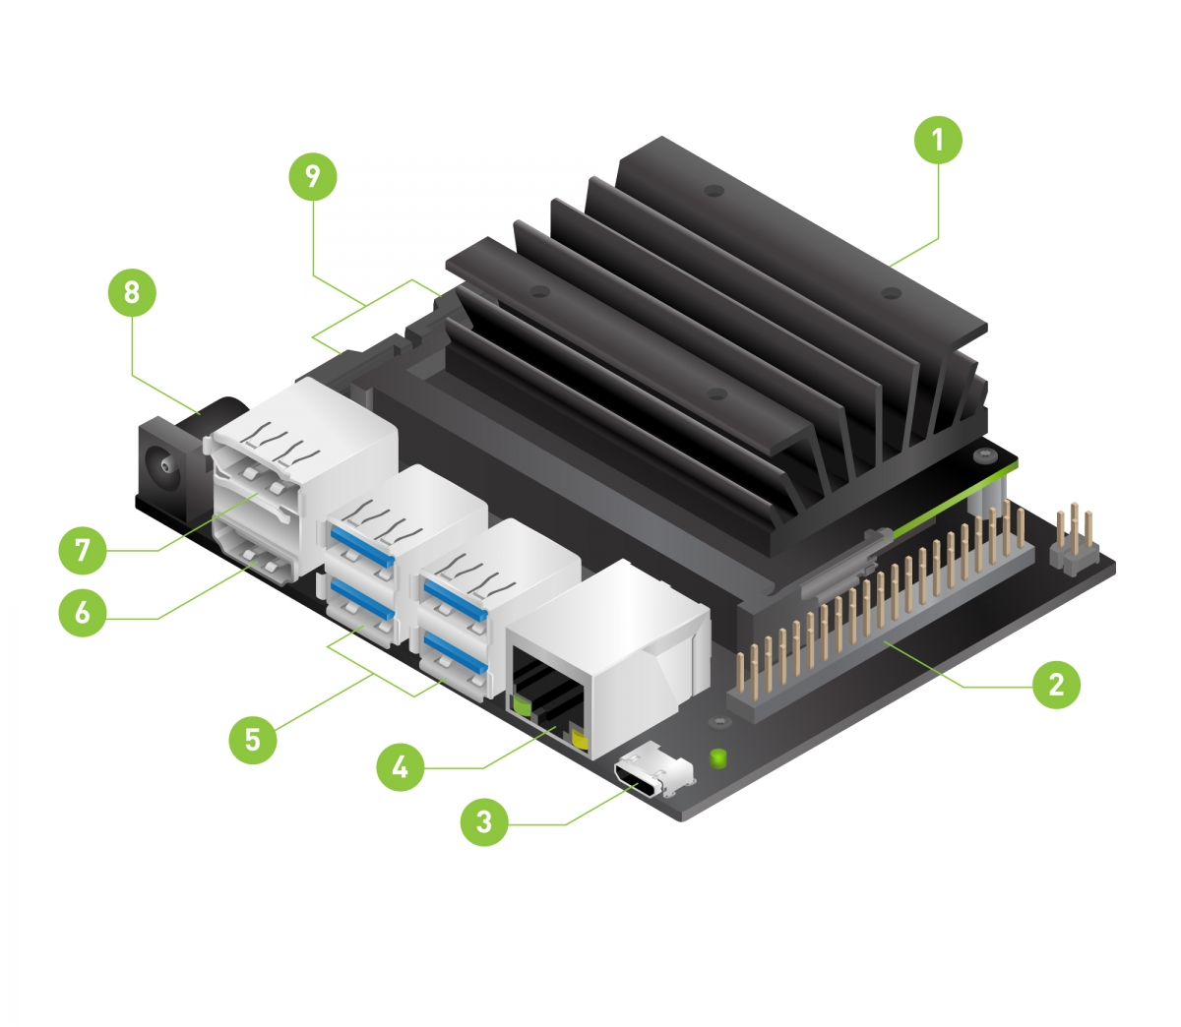
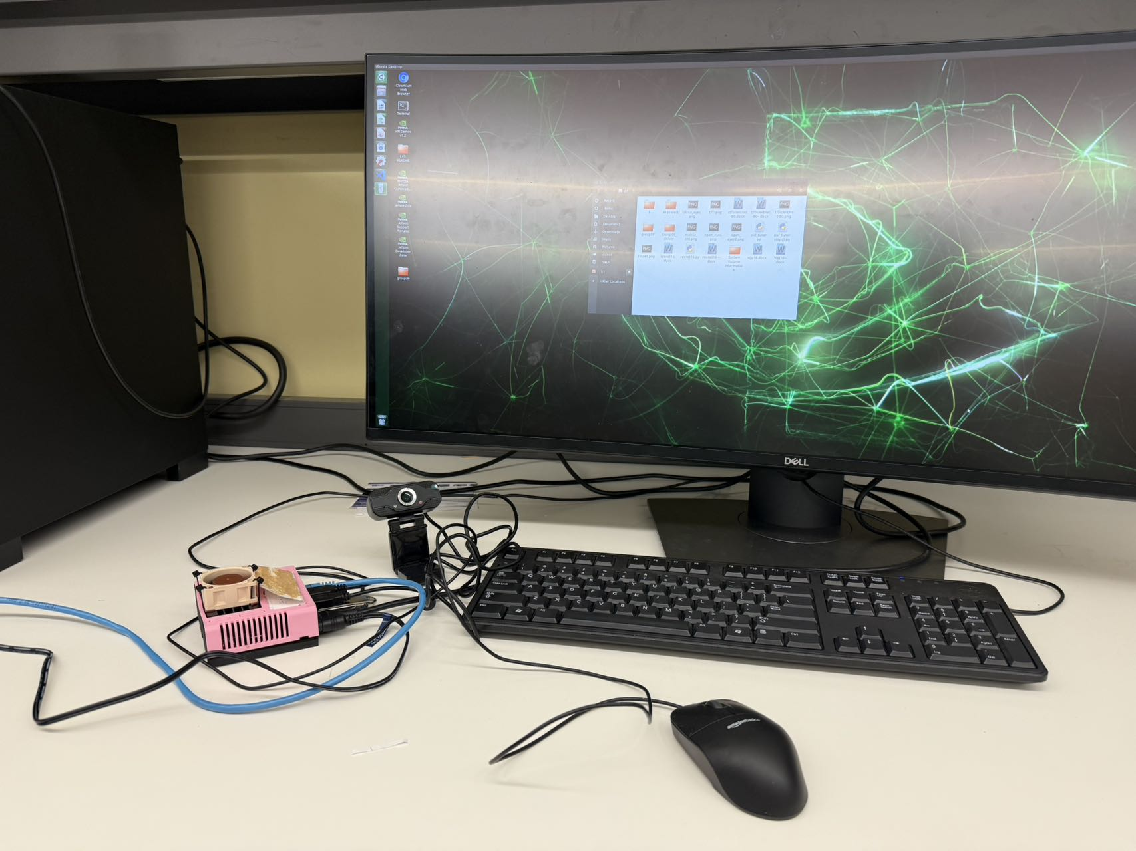
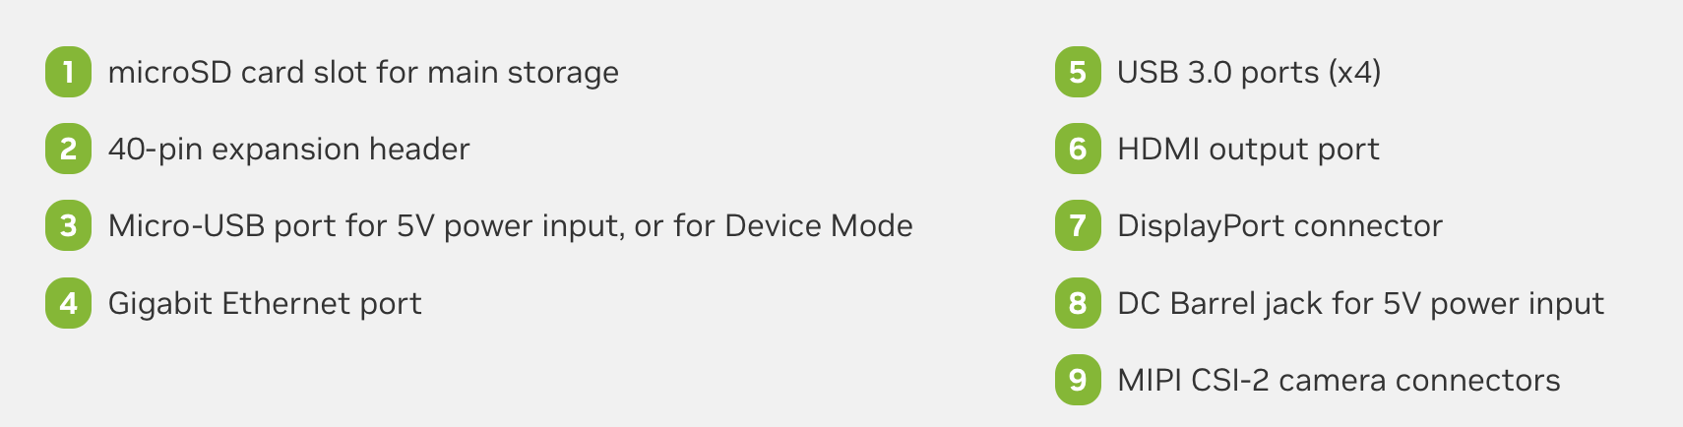
Initial Deployment Setup
Monitor
&
Keyboard
Jetson Nano
Camera
Notes:
The left figure shows the some information of interfaces. The right figure shows the initial setup of the platform.

Slide 5
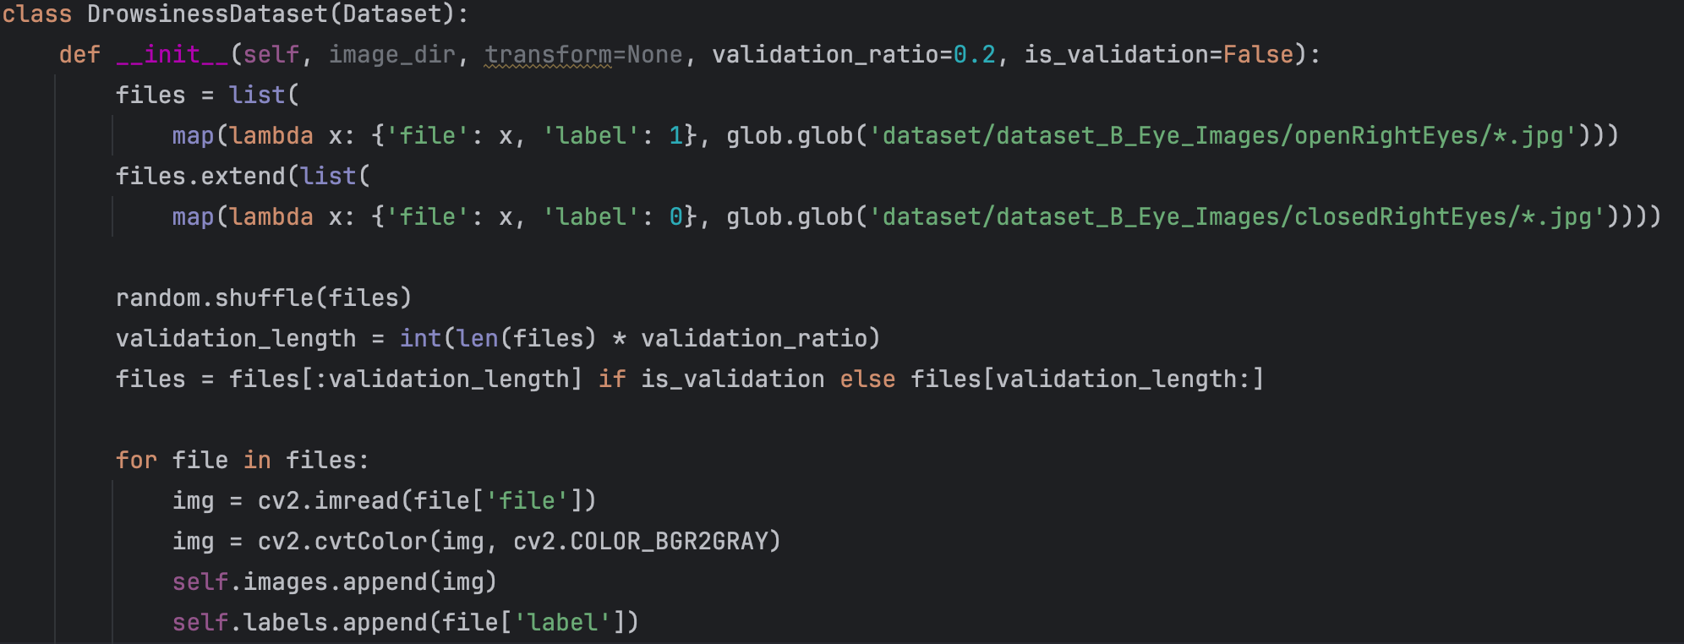
Creates a dataset class to load images, assign labels (1 for open, 0 for closed), and split data into training and validation sets.
Notes:
This code utilizes transfer learning with the pre-trained MobileNetV2 model to build a binary classifier for detecting open and closed eyes. The model learns texture and shape differences between these states through convolutional neural networks. Data is preprocessed with grayscale conversion, resizing, and normalization. A custom dataset class is implemented to load and label images, split data into training and validation sets, and prepare them for model input.

Slide 6
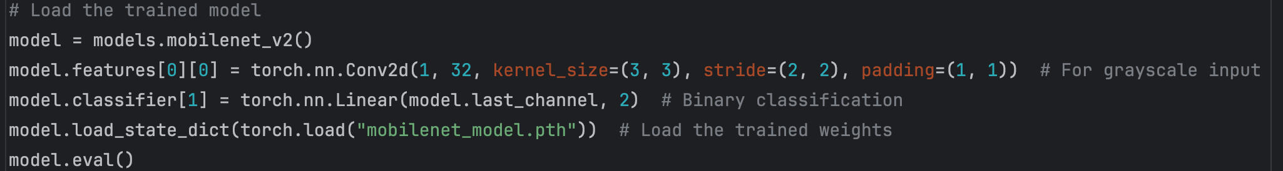
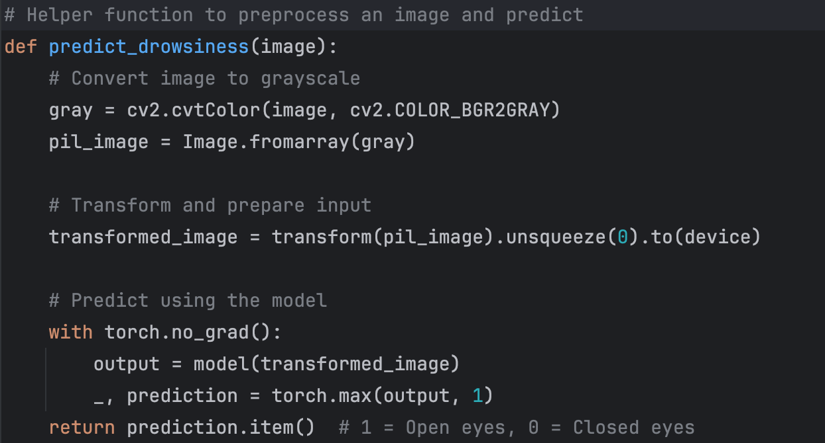
Loads the pre-trained MobileNetV2 model and customizes its input layer for grayscale images and output layer for binary classification.
Converts a single eye image into a model-compatible format and classifies it as "open" or "closed."
Notes:
This code implements a real-time drowsiness detection system using a pre-trained MobileNetV2 model. The system captures video from a webcam, detects faces and eyes using Haar cascades, and classifies each eye as "open" or "closed" based on a trained deep learning model. Input images are preprocessed as grayscale, resized, and normalized before being passed to the model.

Slide 7
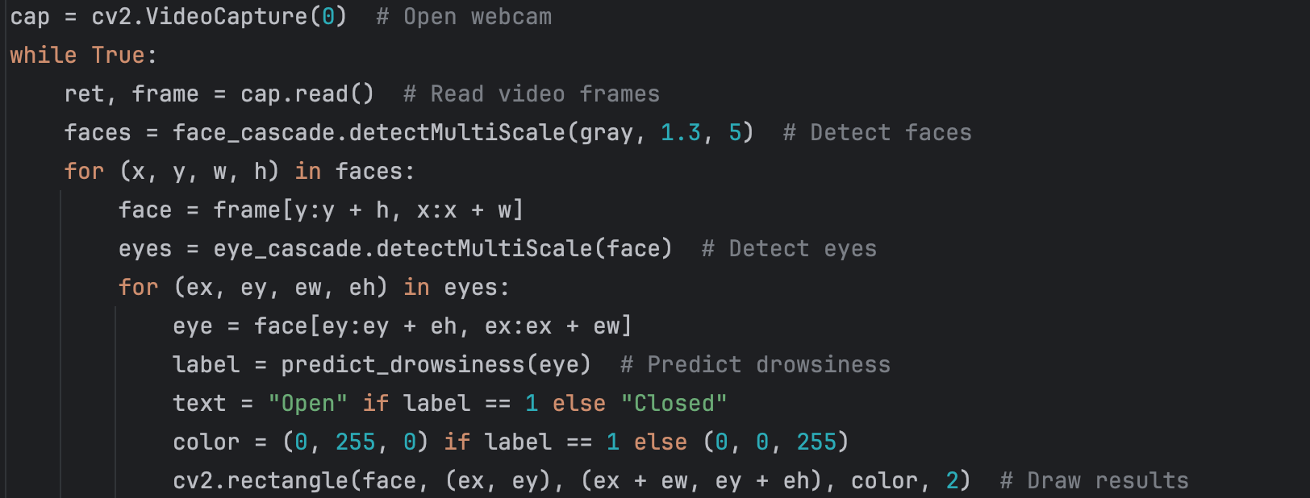
Captures real-time video, detects faces and eyes, classifies each eye, and displays the results.
Notes:
For each detected eye, the system draws a rectangle and labels it as "Open" (green) or "Closed" (red) in real time. This combines computer vision and deep learning for effective real-time monitoring.

Slide 8
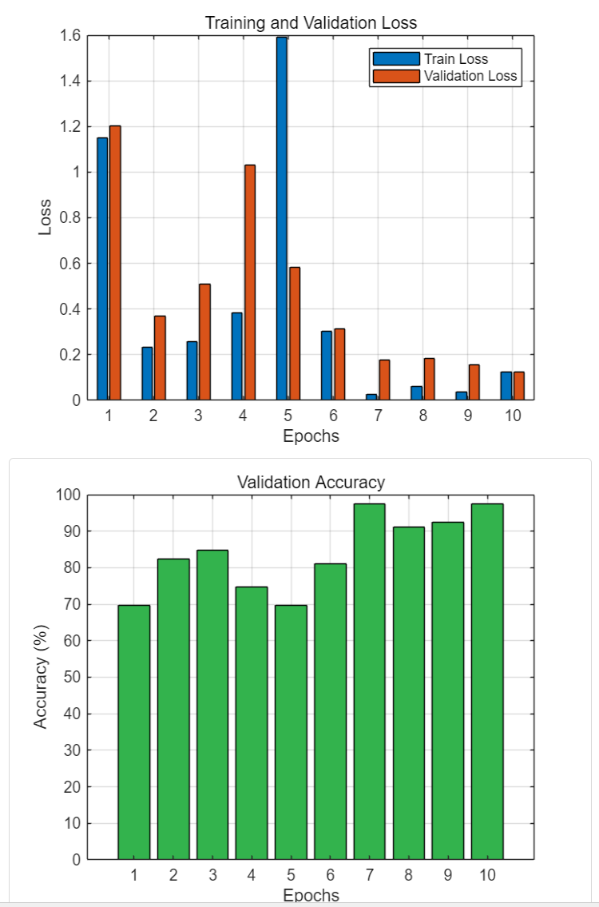
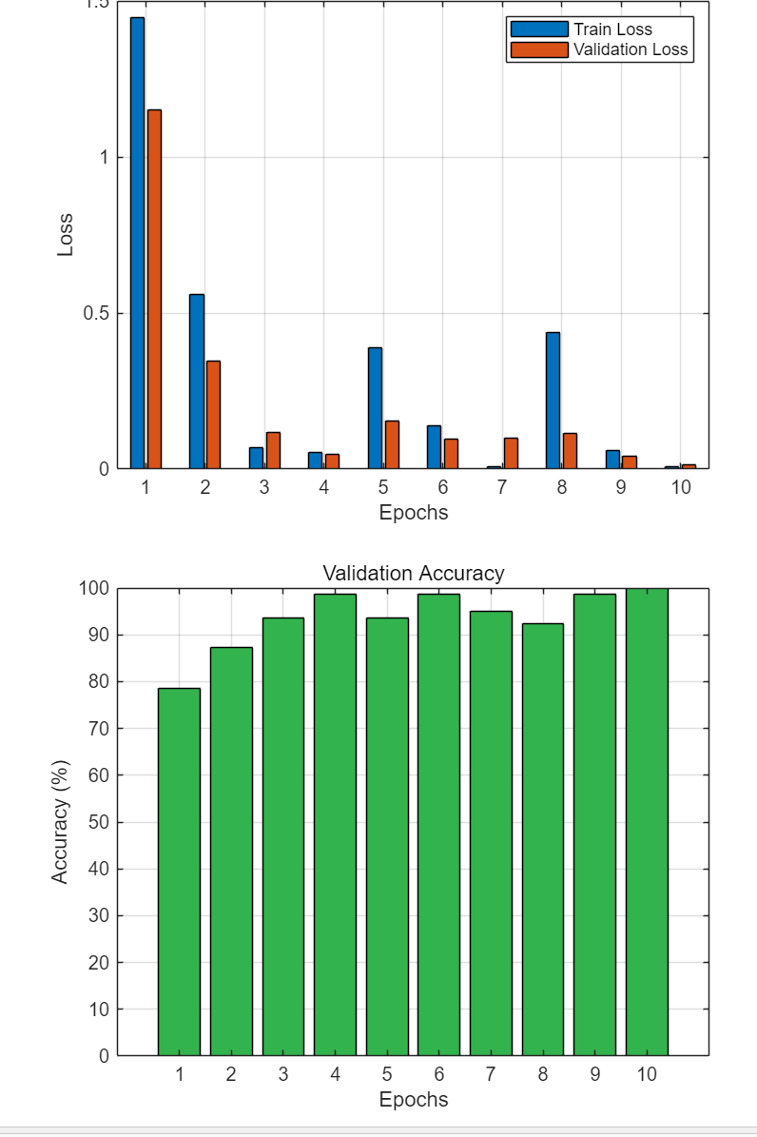
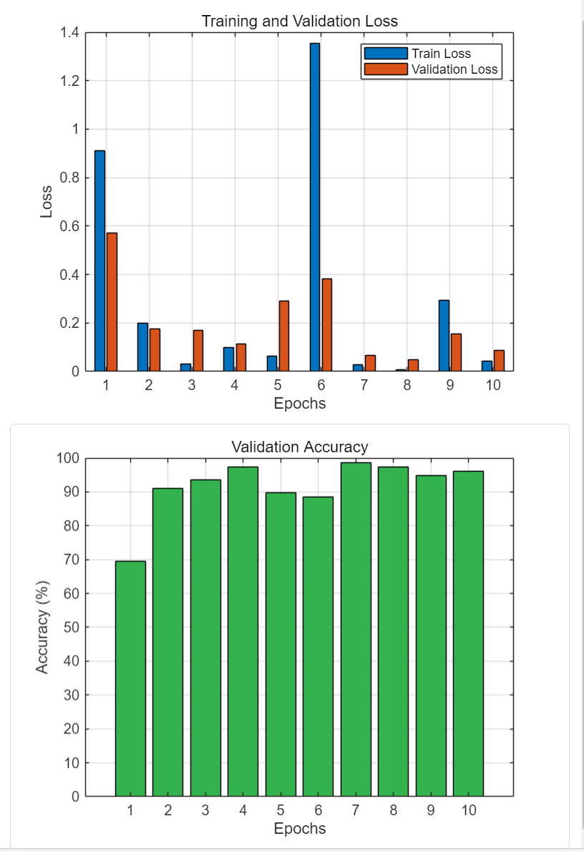
Deployment —— docker
Deployed, tested and compared three modules: ResNet 18, MobileNet and EfficientNet.
ResNet 18
MobileNet
EfficientNet
Notes:
We trained and tested MobileNetV2, ResNet18, and EfficientNet models, and compared them in detail in terms of training loss, verification accuracy, and inference speed. Here are the results
:For the ResNet18 model, validation losses fluctuate significantly at epoch 5, possibly due to overfitting or data distribution issues.
For EfficientNet, the training time and resource requirements are slightly higher.

Slide 9
Why choose MobileNet
Jetson Nano —— A small, low-power device designed for edge AI tasks.
MobileNet
1. Uses fewer computations and memory compared to ResNet or EfficientNet.
2. Built for mobile and embedded devices, while ResNet and EfficientNet require more resources.
3. MobileNet processes images quickly, which is perfect for tasks like real-time object detection.
4. MobileNet models are smaller and can be adjusted to balance accuracy and speed.
Notes:
Finally, we choose the moibleNet.
For MobileNetV2:
During the training process, the loss decreased steadily, the verification loss was low, and the verification accuracy rose rapidly and finally reached 95%.
The advantages are lightweight design and fast inference, which is ideal for real-time tasks on the Jetson Nano.
The following is a demonstration of our running results

Slide 10
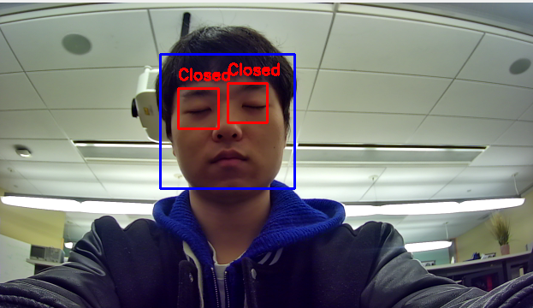
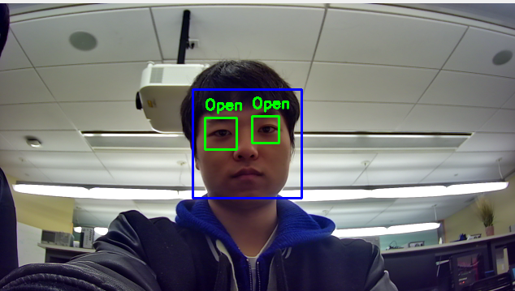
Demo

Slide 11
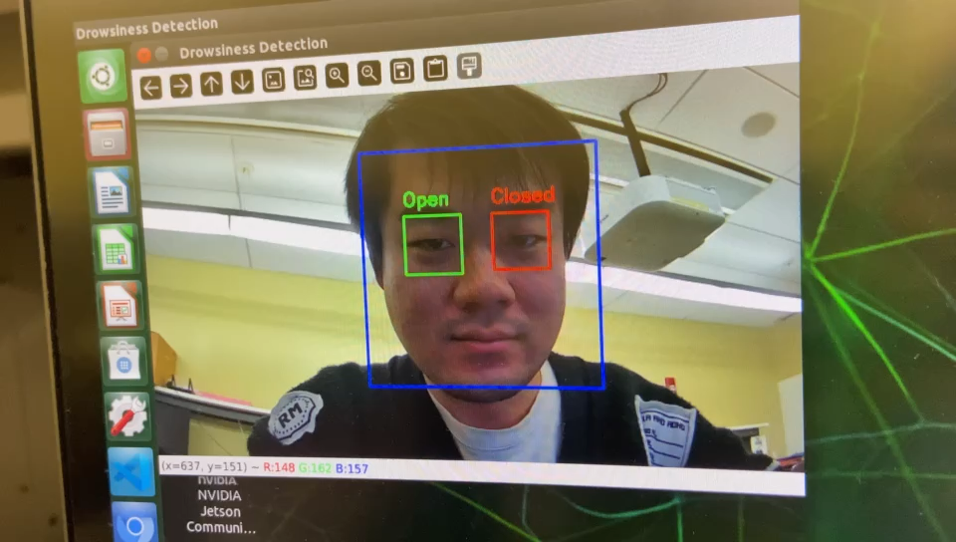
Demo

Slide 12
Conclusion
There are certain limitations in Jetson Nano performance such as its GPU computing power and memory
When real-time requirements are very high or resources are very limited, consider using MobileNet.
Lessons and Optimization
1.Insufficient data augmentation may cause the model to perform poorly for model-specific scenarios (such as light changes or rapid eye opening and closing).
——Increase the diversity of the training set:
(1). Including data for different lighting conditions (angles, blur, etc.).
(2). Apply data augmentation techniques (rotation, brightness adjustment, blurring, etc.) to improve model robustness
2. Judging from the fluctuations in training and validation losses of ResNet18, the model may be overfitting, especially in epoch 5. Model overfitting may cause the training effect to be out of touch with the actual application
Notes:
During the test, we found that there will be some insensitive detection in the test process
Because we reduced the size of the training dataset inorder to pursuit efficiency. This may cause problems with data distribution. The volatility spikes in the Resnet model may be due to this reason.
In order to ensure the accuracy of the identification, we should also increase the diversity of the training ddataset
We can change 50 percent of the image to grayscale, which may avoid the phenomenon of overfitting the model. This allows the model to pay more attention to the structure, shape and other features in the image during training, rather than relying too much on color information

Slide 13
YOLOv5
YOLO (You Only Look Once) v5 is a lightweight object detection model created by Ultralytics
A target detection algorithm that focuses on real-time detection of the location and category of multiple objects in images and videos.
Unlike MobileNet, YOLOv5 focuses more on locating and labeling objects.
Camera Input
(Real-Time Video)
YOLOv5
(Detect Eyes/Face)
MobileNet
(Classify Eye/Face state)
Notes:
Besides eye-detection, yawning detection and nodding detection are also required in the drowsiness driving detection.
To achieve multiple detections, we decided to use YOLOv5 module.
Unlike MobileNet, YOLOv5 focuses more on locating and labeling objects.
However, unfortunatly, we haven't successfully deployed YOLOv5 module on the platform due to some compatibility issues although we tried a lot.

Slide 14
http://venividiwiki.ee.virginia.edu/mediawiki/index.php/JetsonNano
https://docs.edgeimpulse.com/experts/featured-machine-learning-projects/nvidia-omniverse-synthetic-data
Notes:
After completing all we could do, we checked the examples of last year's Jetson Nano group project.
We found that they used Edge Impluse platform which is a mutifunctional integrated platform for edge AI project and successfully deployed YOLOv5 using that platform.
So, we may try on that platform to deploy YOLO to further our project.

Slide 15
Questions?

